Slide 1
Guidelines
Kindly use the given template for submitting your prototype(Make a copy of the template)
One team is only required to submit one project.
Follow this template while preparing your presentation.
You are welcome to add as many POCs and design concepts to support your project.
The project should be feasible and the team members should be capable enough, to come up with the fully functioning prototype of the same idea, if required.
In case of queries, kindly reach out to us at solutionchallengesupport@hack2skill.com
Note: Prototype must include cloud deployment and use at least one Google AI model or service (e.g., Gemini) as part of the solution.

Slide 2


Team Details
Team name: Seeking Squad
Team leader name: Devanshi Chauhan
Problem Statement: Local NGOs and social groups collect valuable community data, but it is often scattered across different sources, making it difficult to identify urgent needs and allocate resources efficiently.

Slide 3
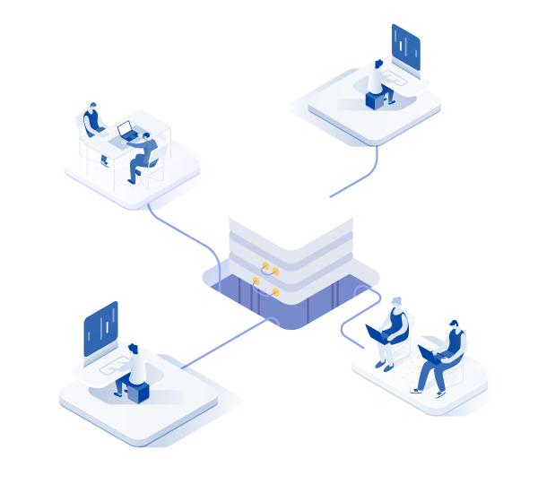
Our Solution – SevaSync AI
Centralized AI Hub: Collects and analyzes real-time community reports using an AI-powered urgency engine.
Automated Triage: Automatically ranks incidents based on severity, population impact and resource requirements.
Actionable Dashboard: Provides NGOs with a real-time command center view for faster decision-making.
Localized Response: Connects users with nearest volunteers and hospitals using smart mapping.

Slide 4

Key Features (Technical Depth)
AI Urgency Scoring: Uses Natural Language Processing(NLP) heuristics to analyze report descriptions and assign priority.
Geospatial Visualization: Interactive Leaflet maps with dynamic markers that change color based on urgency
Smart Volunteer Matching: Algorithms that filter volunteers based on skill sets (Medical, Logistics, Rescue) and proximity.
Dynamic Analytics Dashboard: Live tracking of KPIs like 'Resolution Rate', 'High Urgency Hotspots', and 'Volunteer Deployment’.
Automated Explanations: The AI provides a reasoning for why a specific report was ranked as "High Priority".

Slide 5

How It works
Ingestion: Users submit reports via mobile/web with location data
Processing: FastAPI backend runs AI to assess urgency & needs
Prioritization: Reports stored and pushed to dashboard in real-time
Assignment: NGOs assign tasks to nearby skilled volunteers
Resolution: Volunteers update the status on-field, closing the feedback loop and updating analytics.

Slide 6
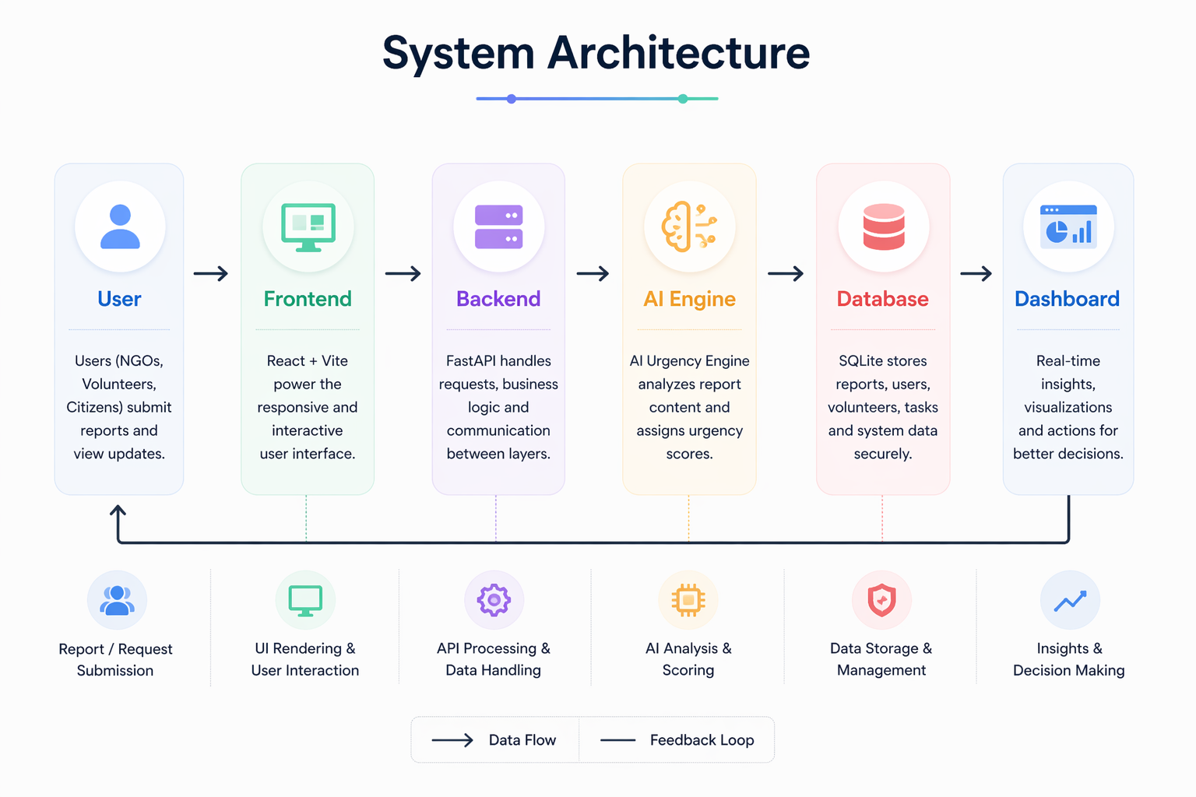

Slide 7
Technologies Used
Fronted
React + Vite(UI)
Tailwind CSS (Glassmorphism design)
Leaflet.js (Maps)
Recharts (Analytics)
Backend
FastAPI (Python)
SQLAIchemy (ORM)
Database
SQLite (Relational storage)

Slide 8
AI Layer
Custom NLP-based Urgency Scoring
Scalable to Google Gemini API
Architecture
REST APIs (JSON-based communication)
Modular Service-Based Architecture
Tools
Node.js, NPM, Unicorn, Git
Postman (API testing)

Slide 9
Estimated implementation cost (optional)

Slide 10
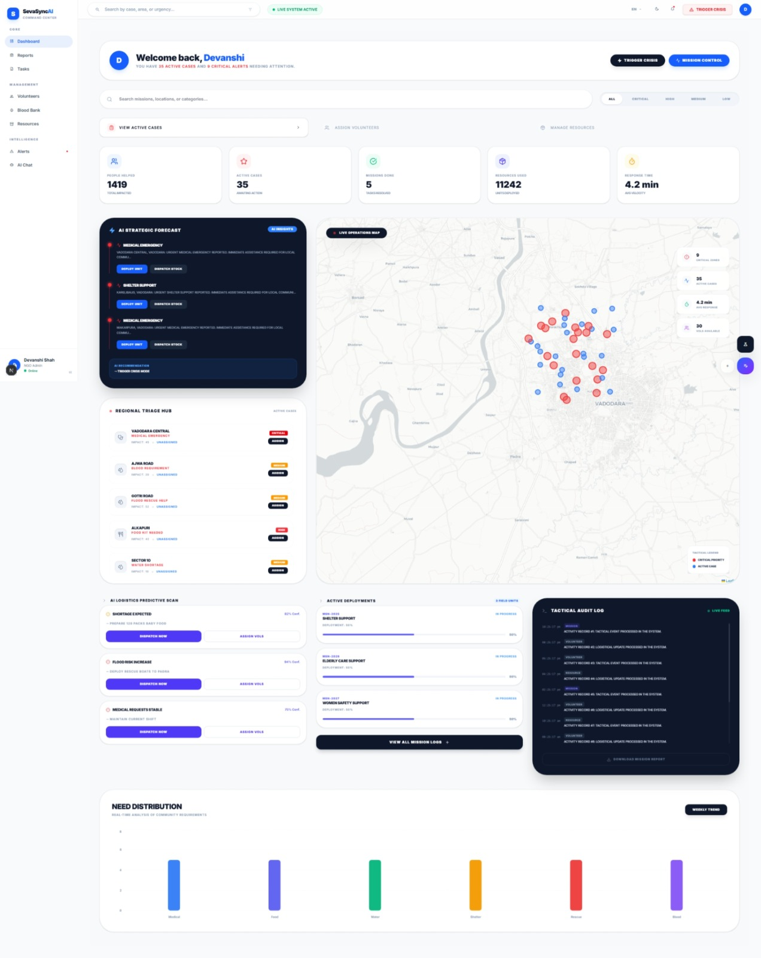
Snapshots of the MVP

Slide 11
Additional Details/Future Development
Gemini AI Vision: Using Google’s Gemini API to automatically analyze disaster photos for instant damage assessment.
Predictive Mapping: Using ML to predict crisis hotspots before they happen based on weather and historical data.
Google Maps Routing: Providing volunteers with real-time "safest routes" to avoid road closures during emergencies.
Offline Reporting: Enabling SMS-based emergency reporting for areas with no internet connectivity.
Global Scalability: Deploying on Google Cloud (GCP) to handle millions of reports simultaneously during large-scale disasters.

Slide 12
Provide links to your:
GitHub Public Repository
Demo Video Link (3 Minutes)
MVP Link
Working Prototype Link

Slide 14


